Slide 1
Adding Navigation to the Site

Slide 2

Overview
Understanding routing in ASP.NET Core MVC
Configuring the routing system
Navigating with tag helpers

Slide 3
Understanding Routing in ASP.NET Core MVC
Notes:
Coming up

Slide 4
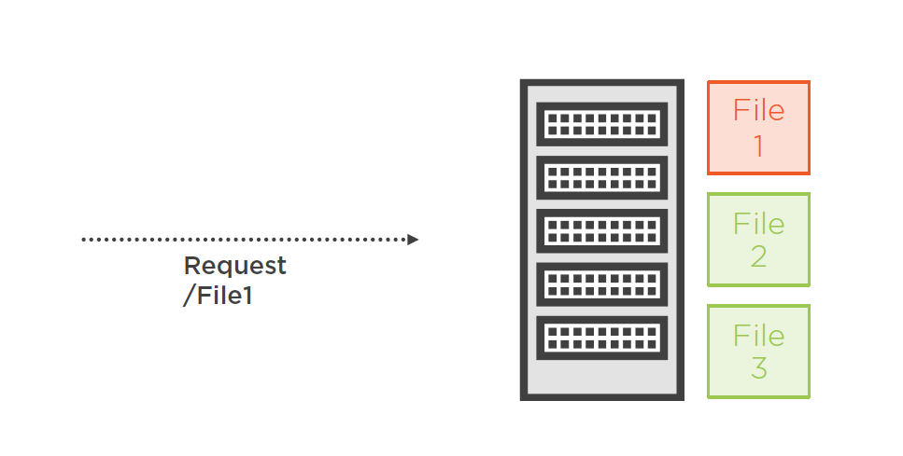
Serving Files

Slide 5
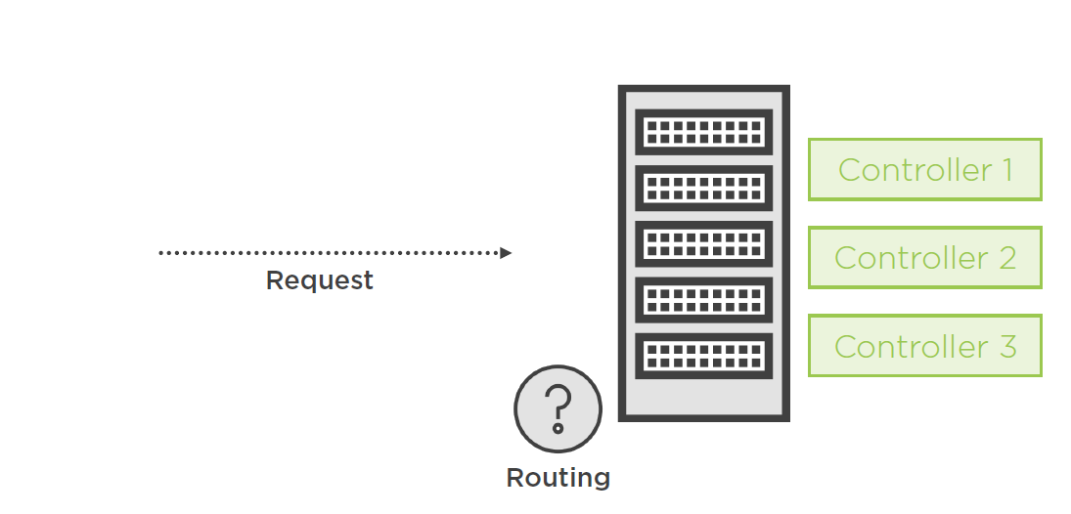
Handing Requests in ASP.NET Core MVC

Slide 6
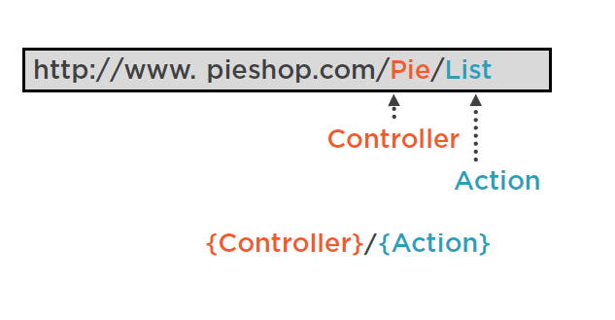
Patterns and Routes

Slide 7
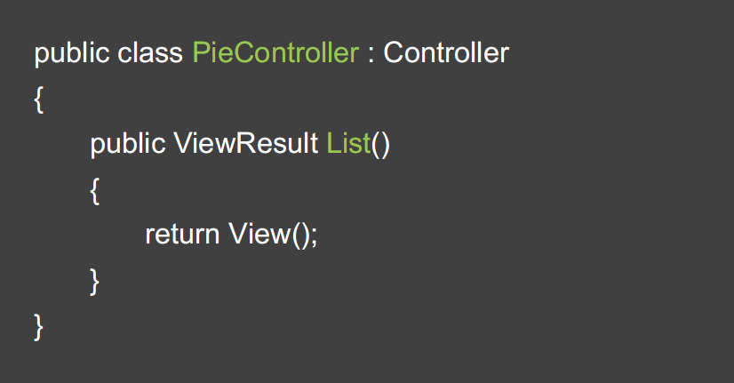
Routing to the Action Method

Slide 8
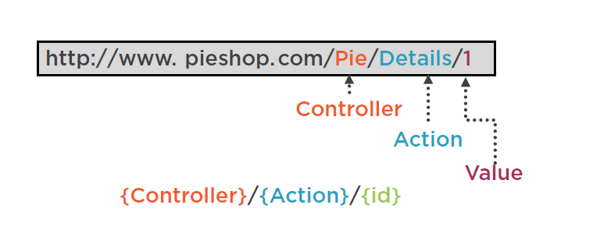
Working with Segments

Slide 9
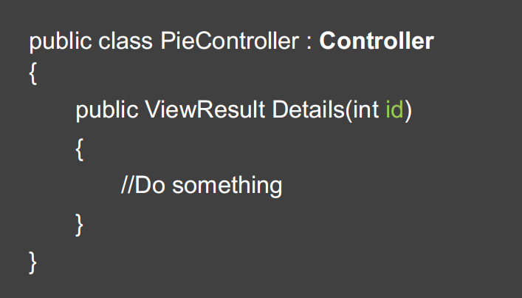
Passing a Value

Slide 10
Configuring the Routing System
Notes:
Coming up

Slide 11
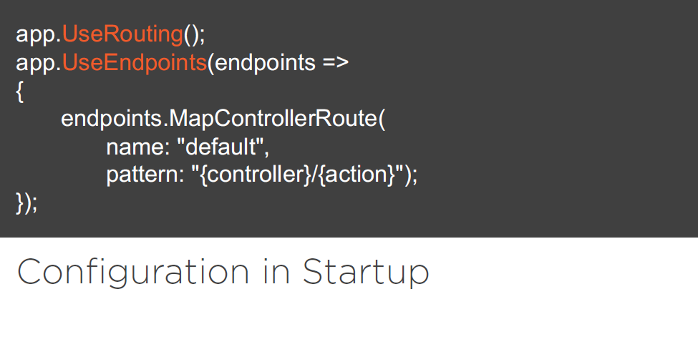
Notes:
Coming up

Slide 12
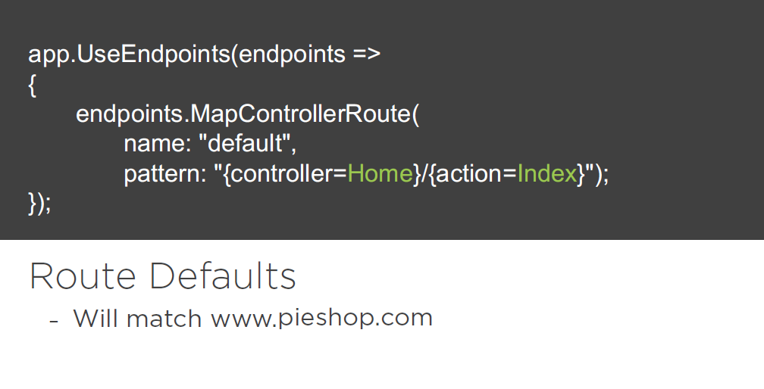
Notes:
Coming up

Slide 13
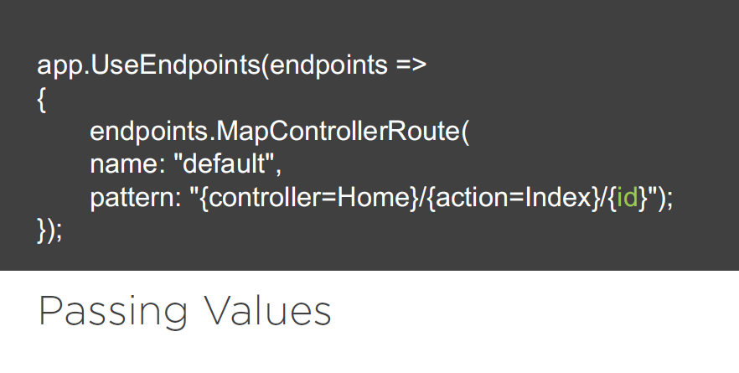
Notes:
Coming up

Slide 14
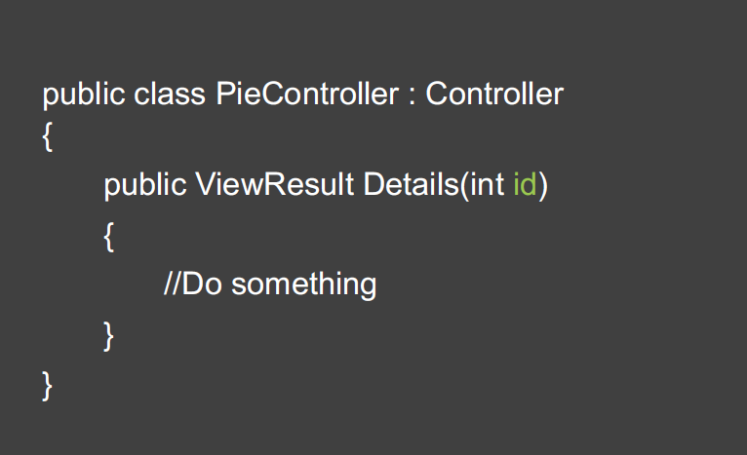
Receiving the Value

Slide 15
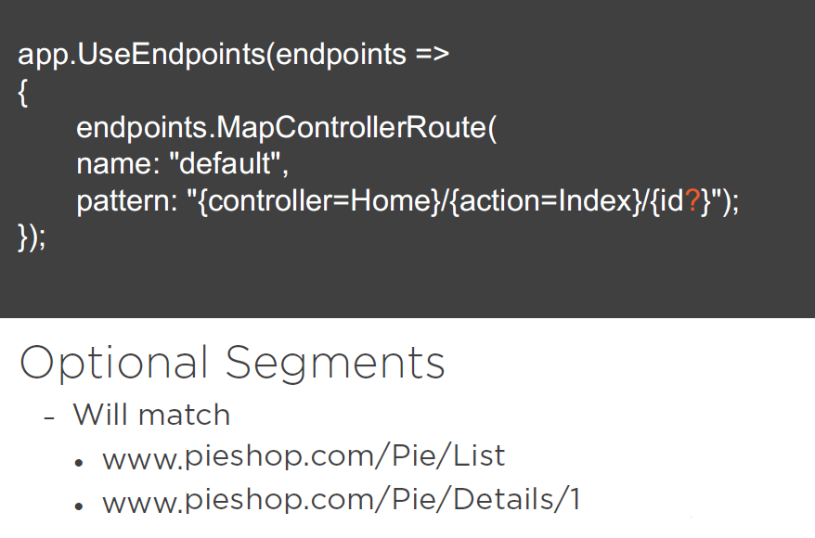

Slide 16
Navigating with Tag Helpers
Notes:
Coming up

Slide 17
We need to generate correct links in the resulting HTML

Slide 18
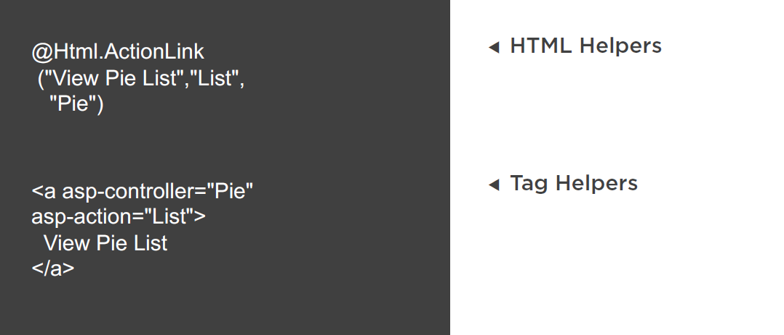

Slide 19
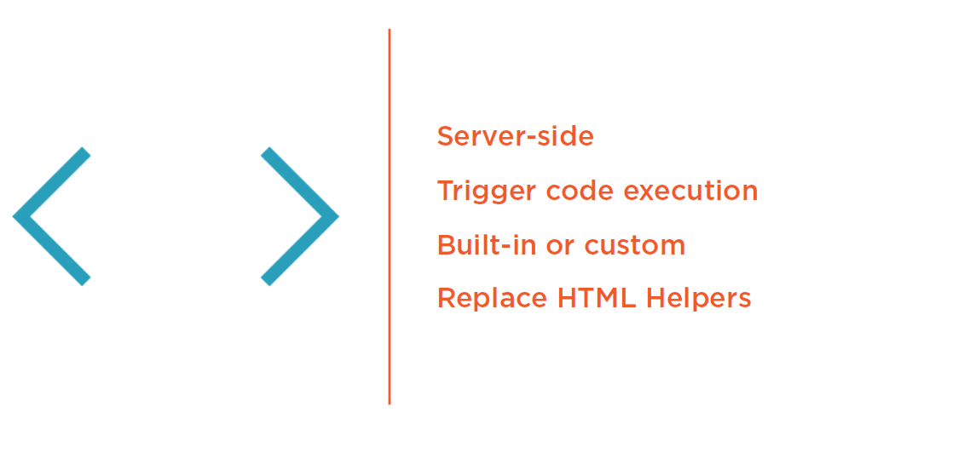
Tag Helpers

Slide 20
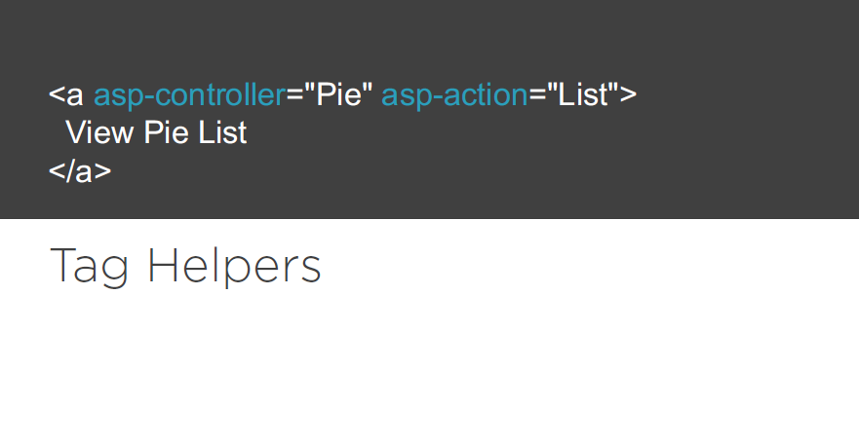

Slide 21
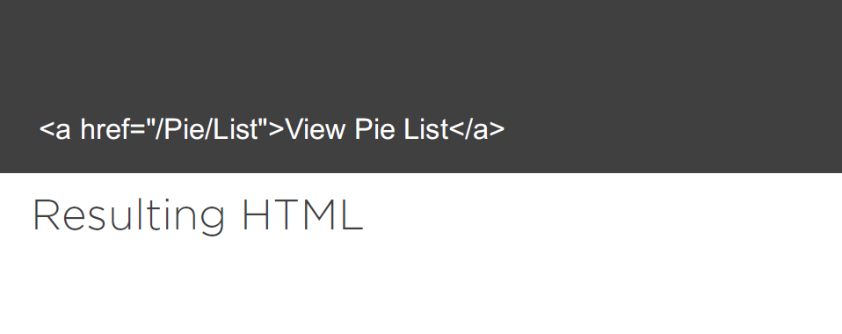

Slide 22

Registering Your Tag Helpers

Slide 23
